Slide 1
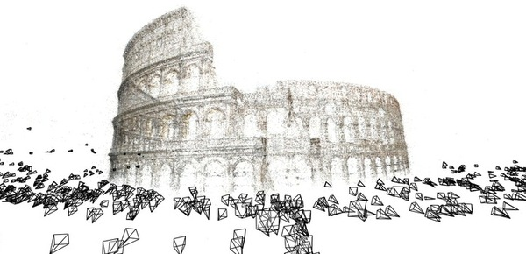
Structure from motion
16-385 Computer Vision
Spring 2020, Lecture 29
http://www.cs.cmu.edu/~16385/

Slide 2
Overview of today’s lecture
A note on normalization.
Two-view structure from motion.
Ambiguities in structure from motion.
Affine structure from motion.
Multi-view structure from motion.
Large-scale structure from motion.

Slide 3
Slide credits
Many of these slides were adapted from:
Kris Kitani (16-385, Spring 2017).
Noah Snavely (Cornell University).
Rob Fergus (New York University).

Slide 4
A note on normalization

Slide 5
Estimating F – 8-point algorithm
The fundamental matrix F is defined by
for any pair of matches x and x’ in two images.
Let x=(u,v,1)^{T} and x’=(u’,v’,1)^{T},
each match gives a linear equation

Slide 6
Problem with 8-point algorithm
~10000
~10000
~100
~10000
~10000
~100
~100
~100
1
Orders of magnitude difference
between column of data matrix
→ least-squares yields poor results
!

Slide 7
Normalized 8-point algorithm
normalized least squares yields good results
Transform image to ~[-1,1]x[-1,1]
(0,500)
(700,500)
(-1,1)
(1,1)
(0,0)
(0,0)
(700,0)
(-1,-1)
(1,-1)

Slide 8
Normalized 8-point algorithm
Transform input by ,
Call 8-point on to obtain

Slide 9
Normalized 8-point algorithm
[x1, T1] = normalise2dpts(x1);
[x2, T2] = normalise2dpts(x2);
A = [x2(1,:)'.*x1(1,:)' x2(1,:)'.*x1(2,:)' x2(1,:)' ...
x2(2,:)'.*x1(1,:)' x2(2,:)'.*x1(2,:)' x2(2,:)' ...
x1(1,:)' x1(2,:)' ones(npts,1) ];
[U,D,V] = svd(A);
F = reshape(V(:,9),3,3)';
[U,D,V] = svd(F);
F = U*diag([D(1,1) D(2,2) 0])*V';
% Denormalise
F = T2'*F*T1;

Slide 10
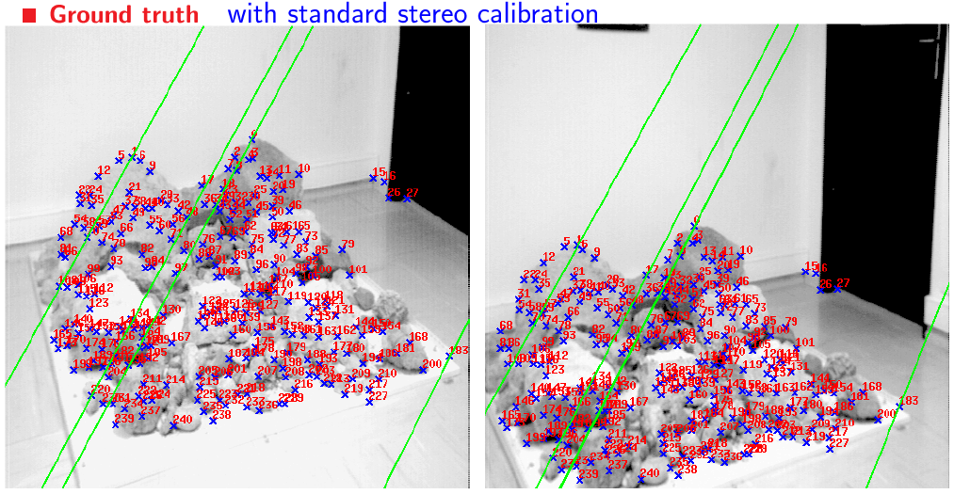
Results (ground truth)

Slide 11
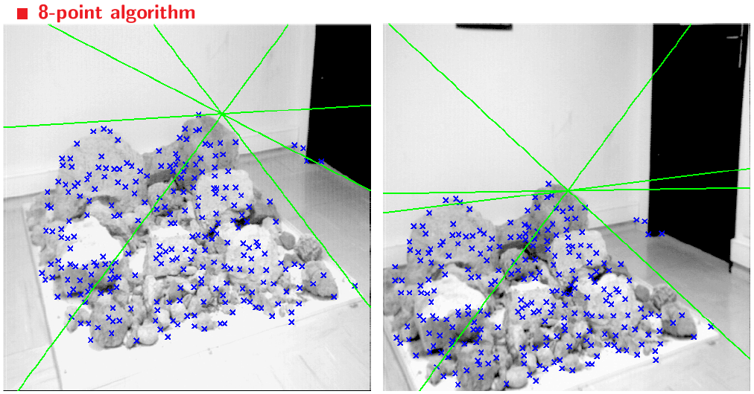
Results (8-point algorithm)

Slide 12
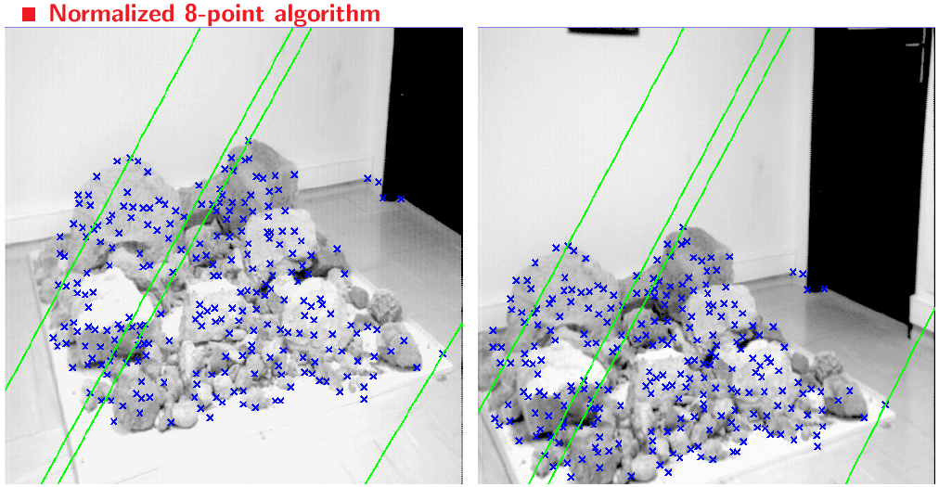
Results (normalized 8-point algorithm)

Slide 13
Two-view structure from motion

Slide 14
 | Structure (scene geometry) | Motion (camera geometry) | Measurements
Pose Estimation | known | estimate | 3D to 2D correspondences
Triangulation | estimate | known | 2D to 2D coorespondences
Reconstruction | estimate | estimate | 2D to 2D coorespondences

Slide 15
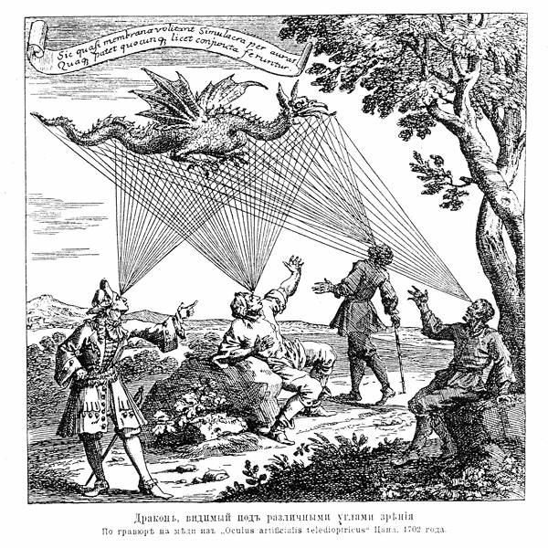
Structure from motion

Slide 16
Camera calibration & triangulation
Suppose we know 3D points
And have matches between these points and an image
How can we compute the camera parameters?
Suppose we have know camera parameters, each of which observes a point
How can we compute the 3D location of that point?

Slide 17
Structure from motion
SfM solves both of these problems at once
A kind of chicken-and-egg problem
(but solvable)

Slide 18
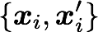
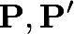
Reconstruction
(2 view structure from motion)
Given a set of matched points
Estimate the camera matrices
Estimate the 3D point

Slide 19


Reconstruction
(2 view structure from motion)
Given a set of matched points
Estimate the camera matrices
‘motion’
(of the cameras)
Estimate the 3D point
‘structure’

Slide 20
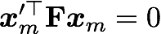
Two-view SfM
Compute the Fundamental Matrix F from points correspondences

Slide 21
Two-view SfM
Compute the Fundamental Matrix F from points correspondences 8-point algorithm

Slide 22
Two-view SfM
Compute the Fundamental Matrix F from points correspondences 8-point algorithm
Compute the camera matrices P from the Fundamental matrix P = [ I | 0 ] and P’ = [ [ex]F | e’ ]

Slide 23

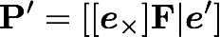
Camera matrices corresponding to the fundamental matrix F may be chosen as
(See Hartley and Zisserman C.9 for proof)

Slide 24

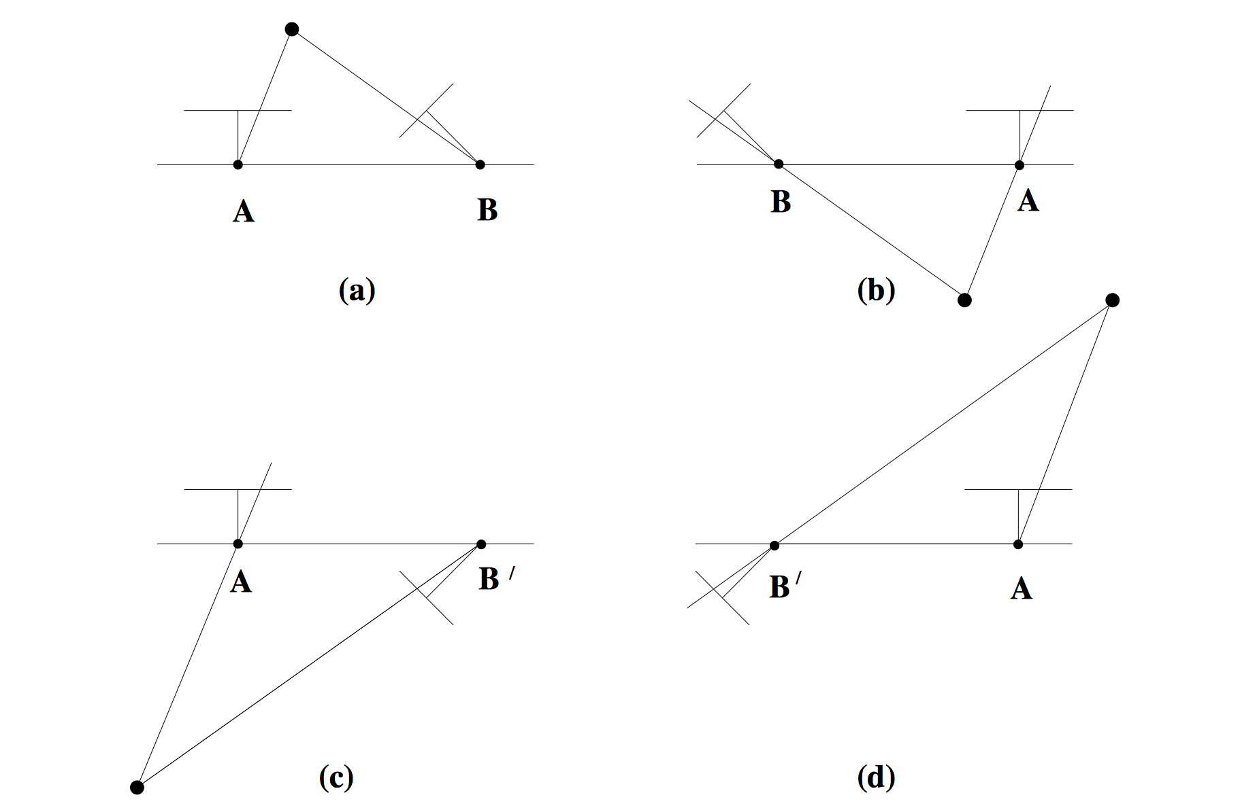
Find the configuration where the points is in front of both cameras

Slide 25
Two-view SfM
Compute the Fundamental Matrix F from points correspondences 8-point algorithm
Compute the camera matrices P from the Fundamental matrix P = [ I | 0 ] and P’ = [ [e’x]F | e’ ]
For each point correspondence, compute the point X in 3D space (triangulation) Triangulation with x = P X and x’ = P’ X

Slide 26

Triangulation
Find 3D object point
image 1
image 2
camera 1 with matrix
camera 2 with matrix

Slide 27
Two-view SfM
Compute the Fundamental Matrix F from points correspondences 8-point algorithm
Compute the camera matrices P from the Fundamental matrix P = [ I | 0 ] and P’ = [ [e’x]F | e’ ]
For each point correspondence, compute the point X in 3D space (triangularization) DLT with x = P X and x’ = P’ X

Slide 28
Is SfM always uniquely solvable?

Slide 29
Ambiguities in structure from motion

Slide 30
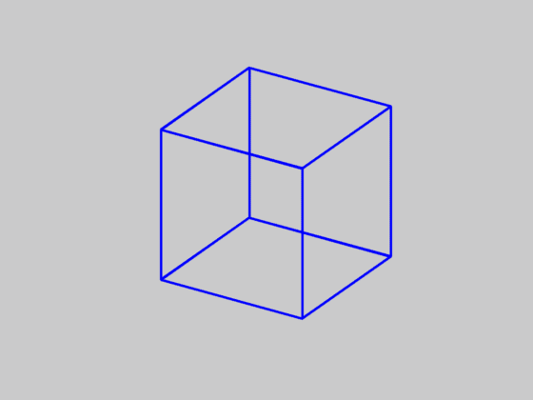
Is SfM always uniquely solvable?
No…

Slide 31
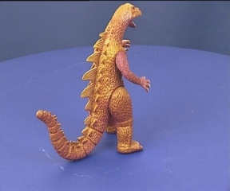
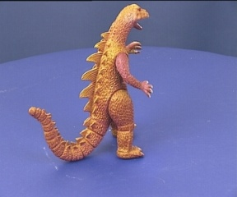
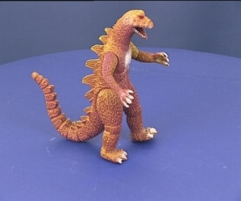
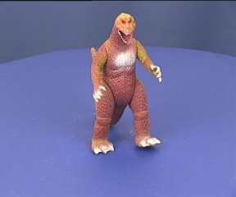
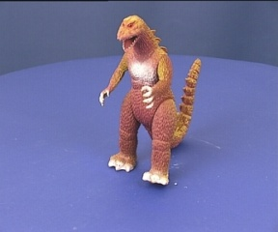
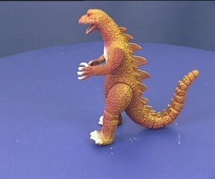
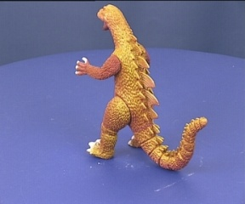
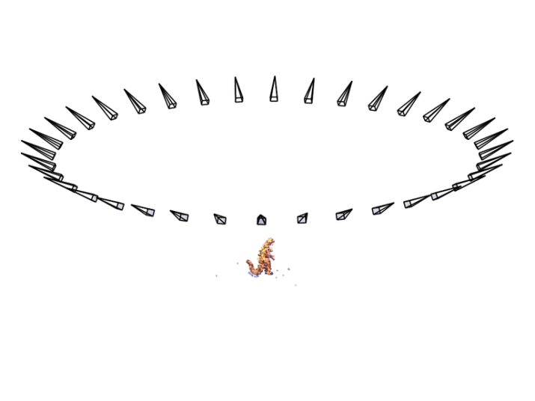
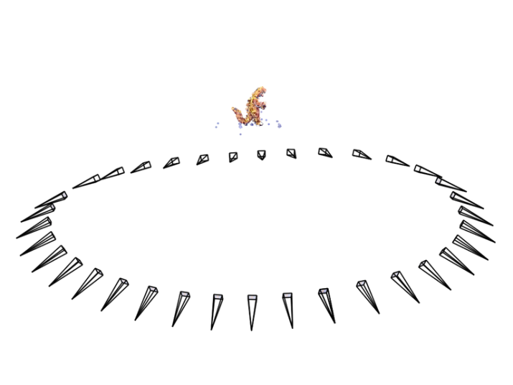
SfM – Failure cases
Necker reversal

Slide 32
Projective Ambiguity
Reconstruction is ambiguous by an arbitrary 3D projective transformation without prior knowledge of camera parameters

Slide 33
Structure from motion
Given: m images of n fixed 3D points
x_{ij} = P_{i} X_{j} , i = 1, … , m, j = 1, … , n
Problem: estimate m projection matrices P_{i} and n 3D points X_{j} from the mn correspondences x_{ij}
X_{j}
x_{1j}
x_{3j}
x_{2j}
P₁
P₃
P₂

Slide 34
Structure from motion ambiguity
If we scale the entire scene by some factor k and, at the same time, scale the camera matrices by the factor of 1/k, the projections of the scene points in the image remain exactly the same:
It is impossible to recover the absolute scale of the scene!

Slide 35
Structure from motion ambiguity
If we scale the entire scene by some factor k and, at the same time, scale the camera matrices by the factor of 1/k, the projections of the scene points in the image remain exactly the same
More generally: if we transform the scene using a transformation Q and apply the inverse transformation to the camera matrices, then the images do not change

Slide 36
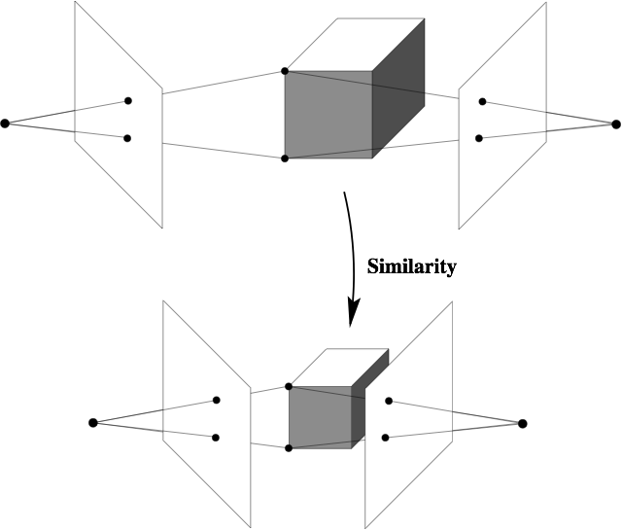
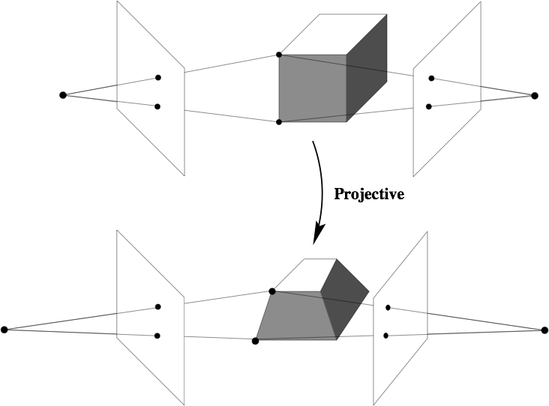
Calibrated cameras
(similarity projection ambiguity)
Uncalibrated cameras
(projective projection ambiguity)

Slide 37
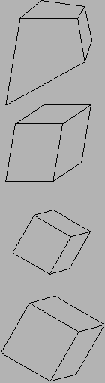
Types of ambiguity
Projective
15dof
Preserves intersection and tangency
Affine
12dof
Preserves parallellism, volume ratios
Similarity
7dof
Preserves angles, ratios of length
Euclidean
6dof
Preserves angles, lengths
With no constraints on the camera calibration matrix or on the scene, we get a projective reconstruction
Need additional information to upgrade the reconstruction to affine, similarity, or Euclidean
Slide: S. Lazebnik

Slide 38
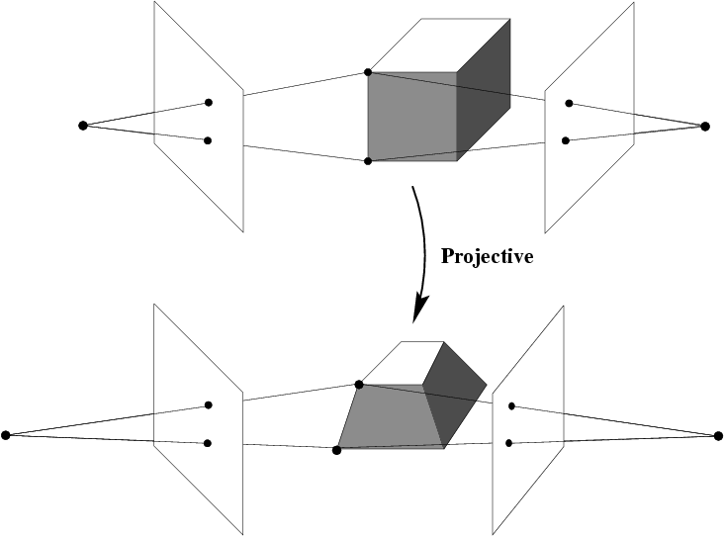
Projective ambiguity

Slide 39
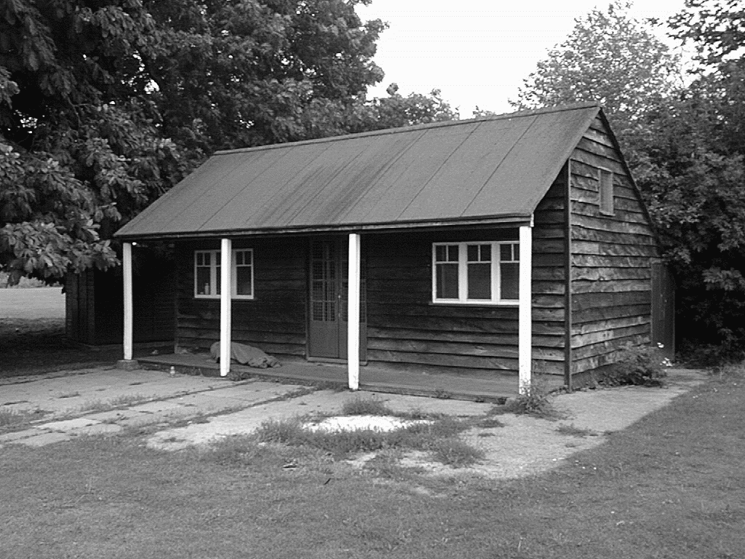
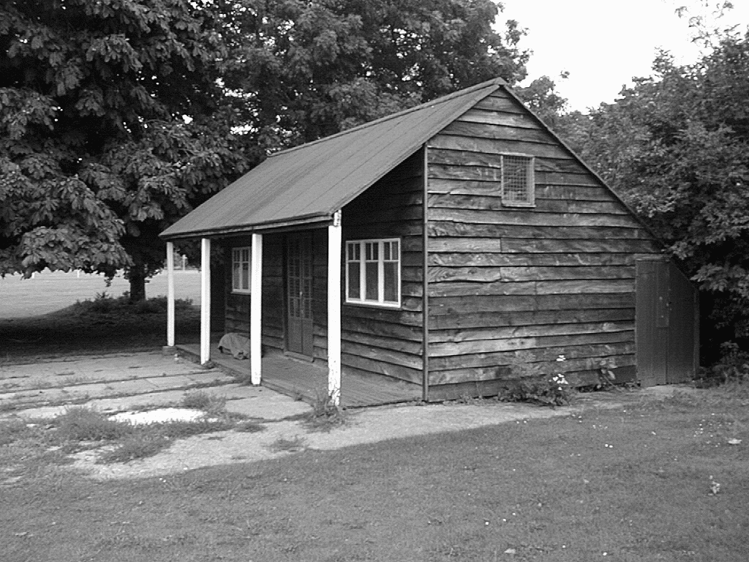
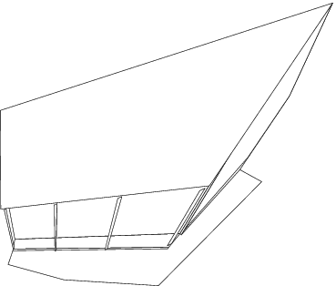
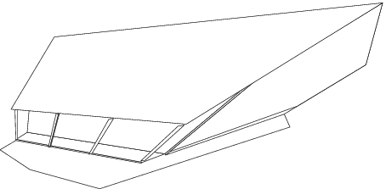
Projective ambiguity

Slide 40
Affine ambiguity
Affine

Slide 41
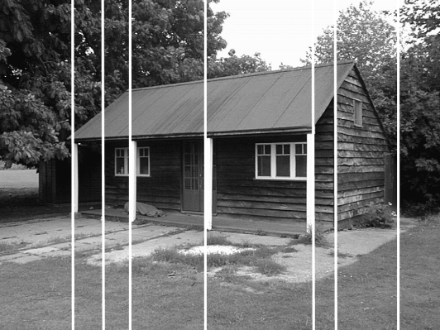
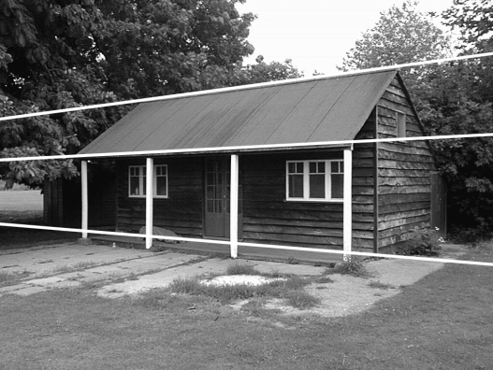
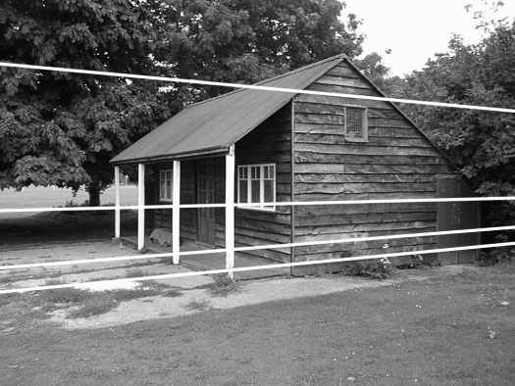
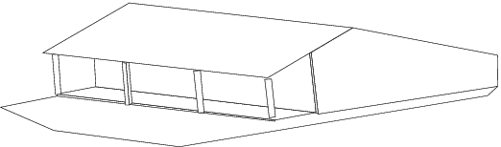
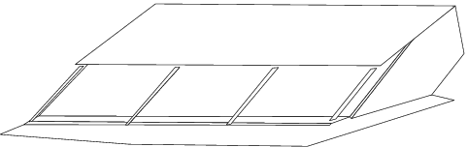
Affine ambiguity

Slide 42
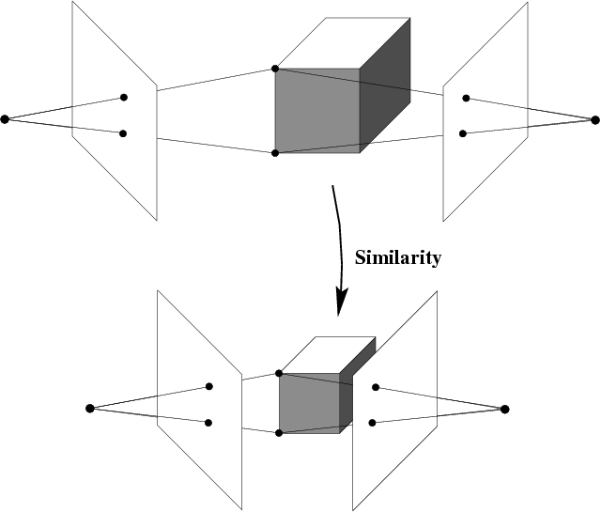
Similarity ambiguity

Slide 43
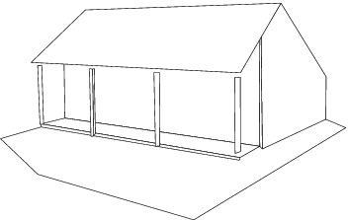
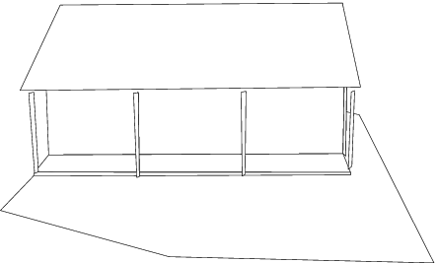
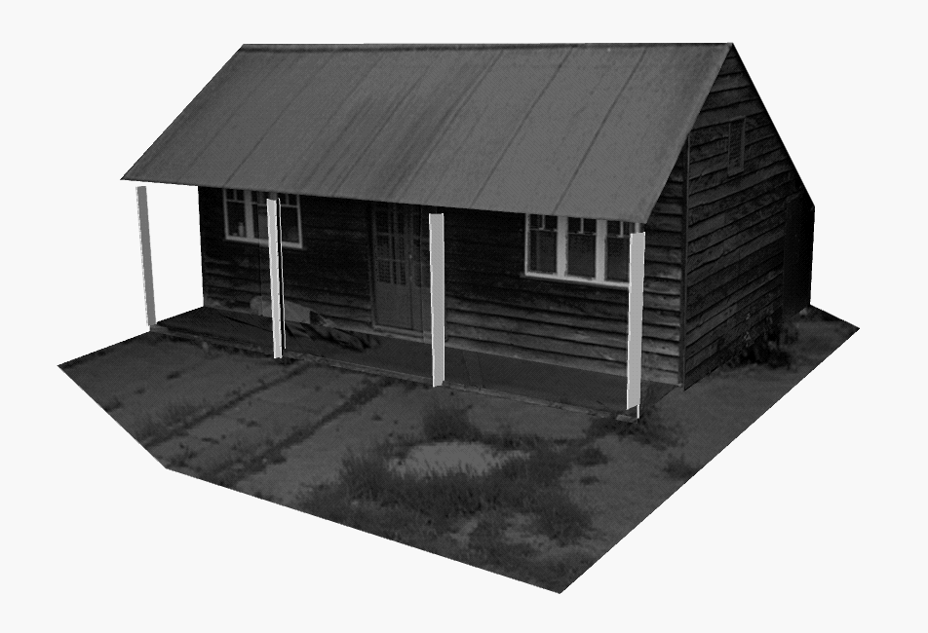
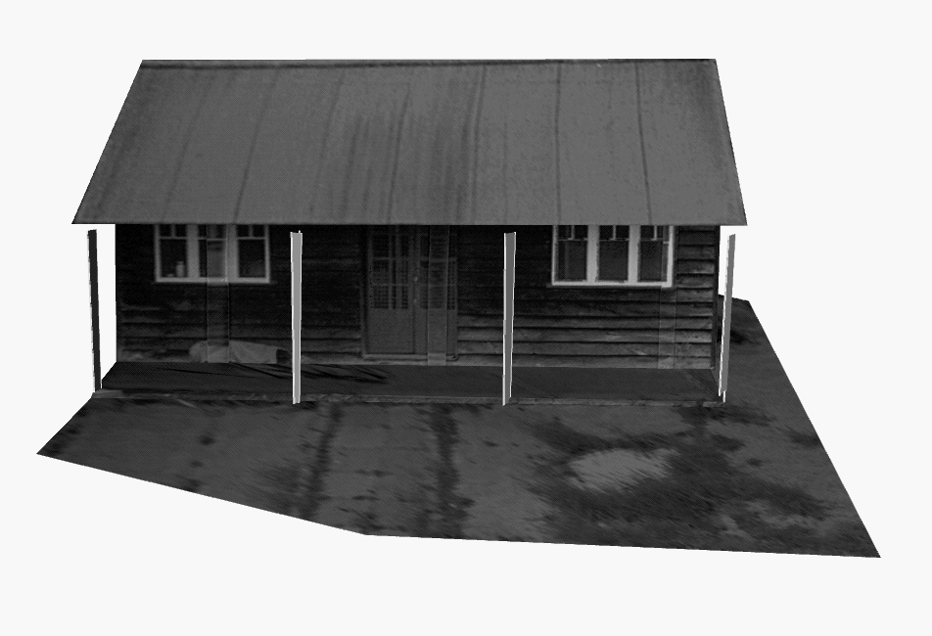
Similarity ambiguity

Slide 44
What can we do to remove ambiguities?

Slide 45
Affine structure from motion

Slide 46
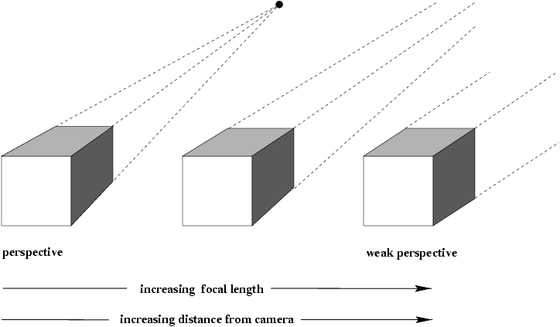
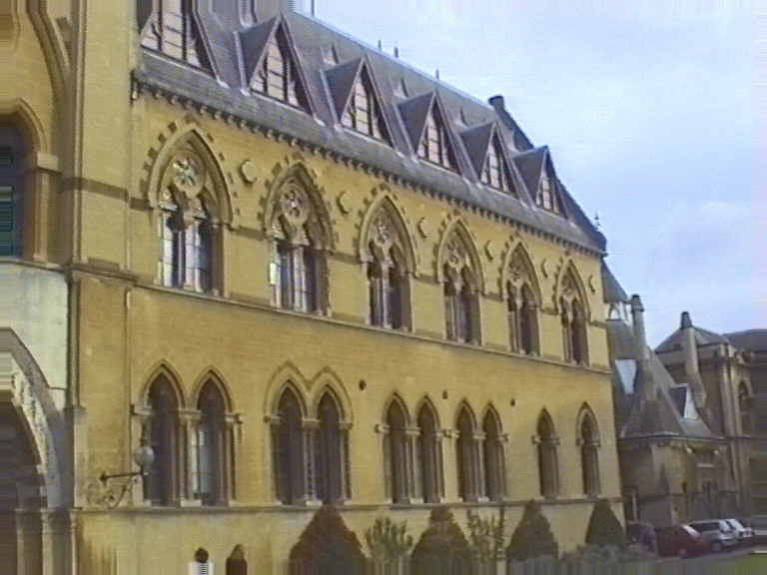
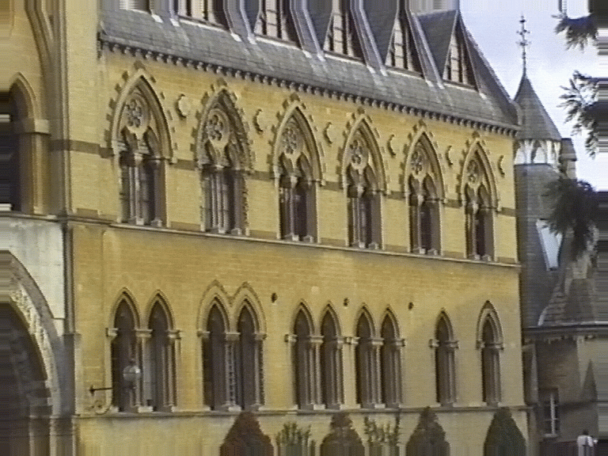
Structure from motion
Let’s start with affine cameras (the math is easier)
center at infinity

Slide 47
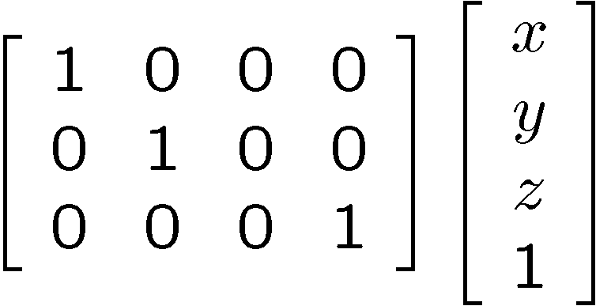
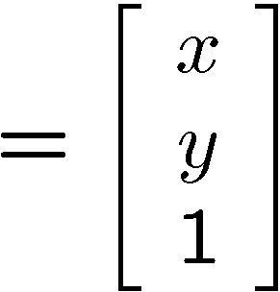
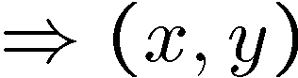
Recall: Orthographic Projection
Special case of perspective projection
Distance from center of projection to image plane is infinite
Projection matrix:
Image
World

Slide 48
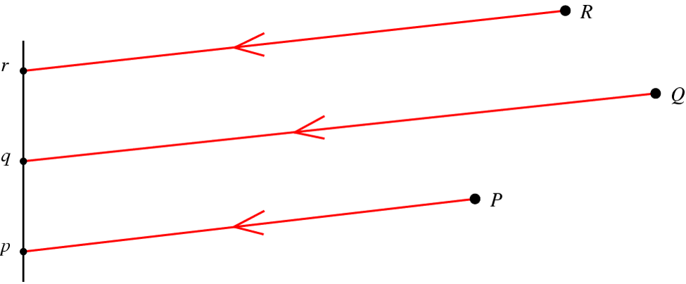
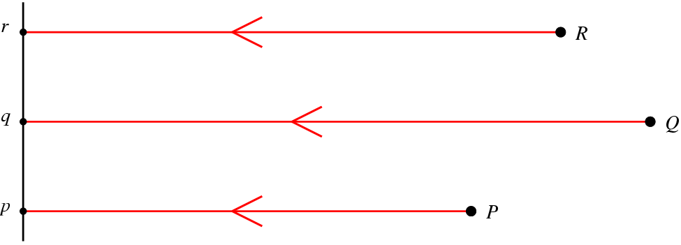
Affine cameras
Orthographic Projection
Parallel Projection

Slide 49
Affine cameras
A general affine camera combines the effects of an affine transformation of the 3D space, orthographic projection, and an affine transformation of the image:
Affine projection is a linear mapping + translation in inhomogeneous coordinates
x
a₂
X
Projection of world origin
a₁

Slide 50
Affine structure from motion
Given: m images of n fixed 3D points:
x_{ij} = A_{i} X_{j} + b_{i} , i = 1,… , m, j = 1, … , n
Problem: use the mn correspondences x_{ij} to estimate m projection matrices A_{i} and translation vectors b_{i}, and n points X_{j}
The reconstruction is defined up to an arbitrary affine transformation Q (12 degrees of freedom):
We have 2mn knowns and 8m + 3n unknowns (minus 12 dof for affine ambiguity)
Thus, we must have 2mn >= 8m + 3n – 12
For two views, we need four point correspondences

Slide 51
Affine structure from motion
Centering: subtract the centroid of the image points
For simplicity, assume that the origin of the world coordinate system is at the centroid of the 3D points
After centering, each normalized point x_{ij} is related to the 3D point X_{i} by

Slide 52
Affine structure from motion
Let’s create a 2m × n data (measurement) matrix:
cameras (2 m)
points (n)
C. Tomasi and T. Kanade. Shape and motion from image streams under orthography: A factorization method. IJCV, 9(2):137-154, November 1992.

Slide 53
Affine structure from motion
Let’s create a 2m × n data (measurement) matrix:
points (3 × n)
cameras (2 m × 3)
The measurement matrix D = MS must have rank 3!
C. Tomasi and T. Kanade. Shape and motion from image streams under orthography: A factorization method. IJCV, 9(2):137-154, November 1992.

Slide 54
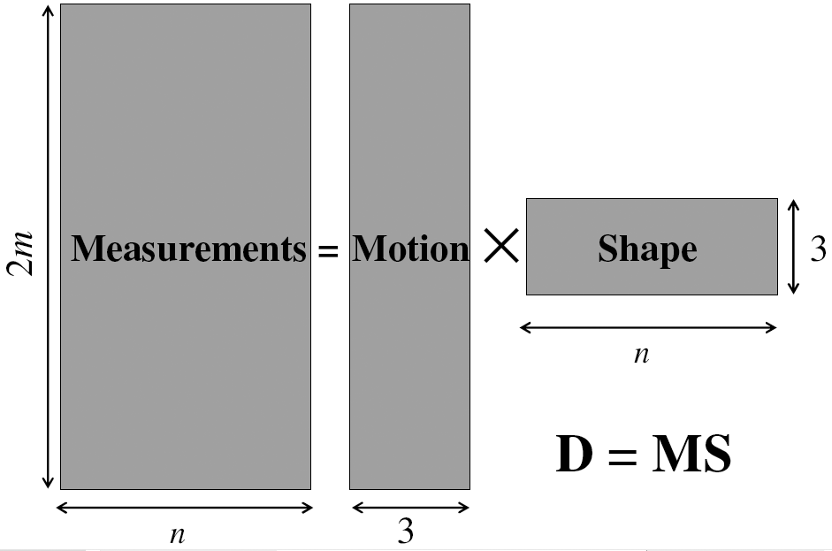
Factorizing the measurement matrix

Slide 55
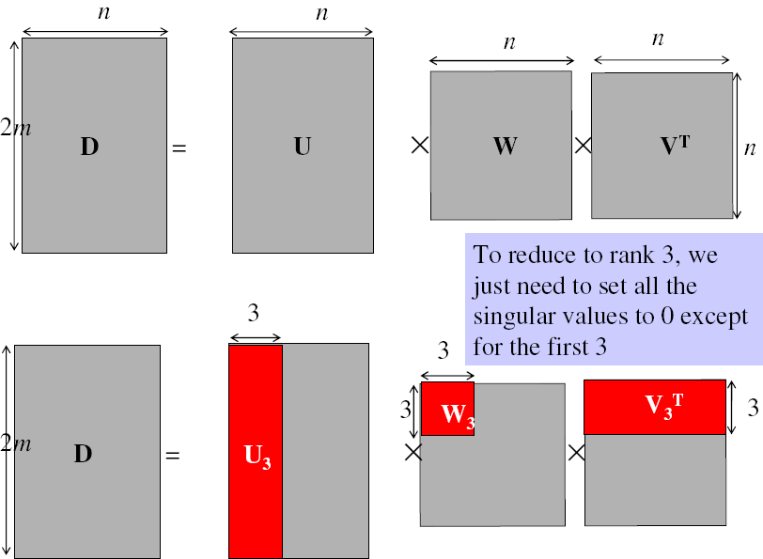
Factorizing the measurement matrix
Singular value decomposition of D:

Slide 56
Factorizing the measurement matrix
Singular value decomposition of D:

Slide 57
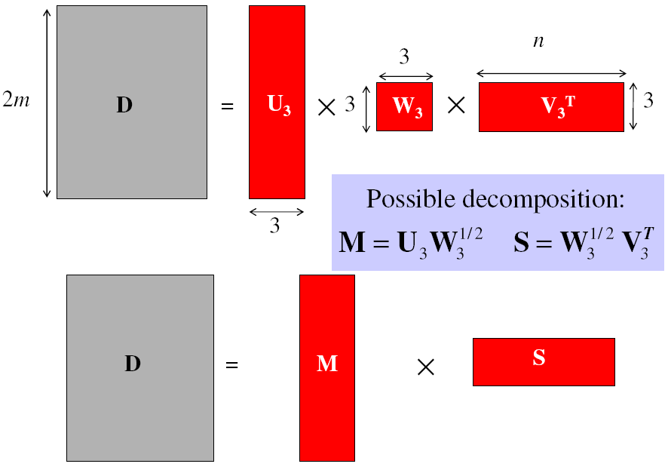
Factorizing the measurement matrix
Obtaining a factorization from SVD:
This decomposition minimizes |D-MS|²

Slide 58
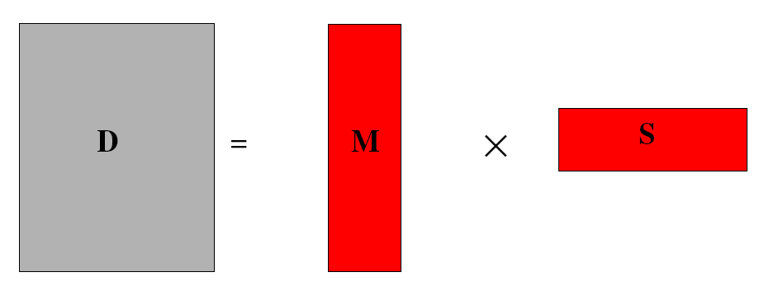
Affine ambiguity
The decomposition is not unique. We get the same D by using any 3×3 matrix C and applying the transformations M → MC, S →C⁻¹S
That is because we have only an affine transformation and we have not enforced any Euclidean constraints (like forcing the image axes to be perpendicular, for example)

Slide 59
Eliminating the affine ambiguity
Orthographic: image axes are perpendicular and of unit length
a₁ · a₂ = 0
x
|a₁|² = |a₂|² = 1
a₂
a₁
X

Slide 60
Solve for orthographic constraints
Solve for L = CC^{T}
Recover C from L by Cholesky decomposition: L = CC^{T}
Update A and X: A = AC, X = C⁻¹X
Three equations for each image i
where
~
~
Slide: D. Hoiem

Slide 61
Algorithm summary
Given: m images and n features x_{ij}
For each image i, center the feature coordinates
Construct a 2m × n measurement matrix D:
Column j contains the projection of point j in all views
Row i contains one coordinate of the projections of all the n points in image i
Factorize D:
Compute SVD: D = U W V^{T}
Create U₃ by taking the first 3 columns of U
Create V₃ by taking the first 3 columns of V
Create W₃ by taking the upper left 3 × 3 block of W
Create the motion and shape matrices:
M = U₃W₃^{½} and S = W₃^{½} V₃^{T} (or M = U₃ and S = W₃V₃^{T})
Eliminate affine ambiguity

Slide 62
Reconstruction results
C. Tomasi and T. Kanade. Shape and motion from image streams under orthography: A factorization method. IJCV, 9(2):137-154, November 1992.

Slide 63
Multi-view projective structure from motion

Slide 64
Projective structure from motion
Given: m images of n fixed 3D points
z_{ij} x_{ij} = P_{i} X_{j} , i = 1,… , m, j = 1, … , n
Problem: estimate m projection matrices P_{i} and n 3D points X_{j} from the mn correspondences x_{ij}
X_{j}
x_{1j}
x_{3j}
x_{2j}
P₁
P₃
P₂

Slide 65
Projective structure from motion
Given: m images of n fixed 3D points
z_{ij} x_{ij} = P_{i} X_{j} , i = 1,… , m, j = 1, … , n
Problem: estimate m projection matrices P_{i} and n 3D points X_{j} from the mn correspondences x_{ij}
With no calibration info, cameras and points can only be recovered up to a 4x4 projective transformation Q:
X → QX, P → PQ⁻¹
We can solve for structure and motion when
2mn >= 11m +3n – 15
For two cameras, at least 7 points are needed

Slide 66
Projective SFM: Two-camera case
Compute fundamental matrix F between the two views
First camera matrix: [I|0]
Second camera matrix: [A|b]
Then b is the epipole (F^{T}b = 0), A = –[b×]F

Slide 67

Sequential structure from motion
Initialize motion from two images using fundamental matrix
Initialize structure by triangulation
For each additional view:
Determine projection matrix of new camera using all the known 3D points that are visible in its image – calibration
points
cameras

Slide 68

Sequential structure from motion
Initialize motion from two images using fundamental matrix
Initialize structure by triangulation
For each additional view:
Determine projection matrix of new camera using all the known 3D points that are visible in its image – calibration
Refine and extend structure: compute new 3D points, re-optimize existing points that are also seen by this camera – triangulation
points
cameras

Slide 69

Sequential structure from motion
Initialize motion from two images using fundamental matrix
Initialize structure by triangulation
For each additional view:
Determine projection matrix of new camera using all the known 3D points that are visible in its image – calibration
Refine and extend structure: compute new 3D points, re-optimize existing points that are also seen by this camera – triangulation
Refine structure and motion: bundle adjustment
points
cameras

Slide 70
Bundle adjustment
Non-linear method for refining structure and motion
Minimizing reprojection error
X_{j}
P₁X_{j}
x_{1j}
x_{3j}
P₃X_{j}
P₂X_{j}
x_{2j}
P₁
P₃
P₂

Slide 71
Review: Structure from motion
Ambiguity
Affine structure from motion
Factorization
Dealing with missing data
Incremental structure from motion
Projective structure from motion
Bundle adjustment

Slide 72
 | Structure (scene geometry) | Motion (camera geometry) | Measurements
Pose Estimation | known | estimate | 3D to 2D correspondences
Triangulation | estimate | known | 2D to 2D coorespondences
Reconstruction | estimate | estimate | 2D to 2D coorespondences

Slide 73
Large-scale structure from motion

Slide 74







Structure from motion
Reconstruction (side)
(top)
Input: images with points in correspondence p_{i,j} = (u_{i,j},v_{i,j})
Output
structure: 3D location x_{i} for each point p_{i}
motion: camera parameters R_{j} , t_{j} possibly K_{j}
Objective function: minimize reprojection error

Slide 75




15,464
37,383
76,389

Slide 76

Standard way to view photos
Notes:
Advances in digital camera technology and the popularity of photo-sharing sites such as Flickr have resulted in the availability of vast numbers of photos. Doing a Flickr search for a famous place like the Trevi Fountain, returns thousands of photos. Unfortunately, common image browsing tools don’t give a sense of a rich relationships between all of the photos.
The goal of Photo Tourism is to use location information to build a better visualization and photo exploration tool for collections of photos of the same scene.
[If I do a search for Trevi and Rome in Flickr, you’ll see a typical way of browsing such collections – looking at page after page of thumbnails. If I have a specific kind of photo of the Trevi Fountain in mind, it can be hard to find it this way, and the relationships between all the photos isn’t clear.
The goal of the Photo Tourism project is to use location information to build a better visualization and photo exploration tool for collections of photos of the same scene.]
[Here’s a sample search for “Trevi Fountain” on Flickr – results are returned on pages and pages of thumbnails. Finding a photo of a specific part of the fountain amounts to scrolling through the thumbnails, and it’s not clear how all the photos are related to each other.
The goal of the Photo Tourism project is to use location information to build a better visualization and photo exploration tool for collections of photos of the same scene.]
4/29/2020
76

Slide 77

Photo Tourism
Notes:
Here’s how the same set of photos appear in our photo explorer. Our system takes the set of photos and automatically determines the relative positions and orientations from which each photo was taken. We can then load the photos into our immersive 3D browser where the user can visualize and explore the photos using spatial relationships.

Slide 78

Input: Point correspondences

Slide 79
















Feature detection
Detect features using SIFT [Lowe, IJCV 2004]
Notes:
So, we begin by detecting SIFT features in each photo.
[We detect SIFT features in each photo, resulting in a set of feature locations and 128-byte feature descriptors…]

Slide 80





Feature description
Describe features using SIFT [Lowe, IJCV 2004]

Slide 81




Feature matching
Match features between each pair of images
Notes:
Next, we match features across each pair of photos using approximate nearest neighbor matching.

Slide 82


Feature matching
Refine matching using RANSAC to estimate fundamental matrix between each pair
Notes:
The matches are refined by using RANSAC, which is a robust model-fitting technique, to estimate a fundamental matrix between each pair of matching images and keeping only matches consistent with that fundamental matrix.
We then link connected components of pairwise feature matches together to form correspondences across multiple images.
Once we have correspondences, we run structure from motion to recover the camera and scene geometry. Structure from motion solves the following problem:

Slide 83




Correspondence estimation
Link up pairwise matches to form connected components of matches across several images
Image 1
Image 2
Image 3
Image 4
Notes:
The next step of our reconstruction algorithm is to link up matches between pairs of images into correspondences between multiple images, by finding connected components of matches. Suppose among these images, these features are matched only between consecutive pairs of images, perhaps because the scales of the images are so different. During correspondence estimation we link these matches and consider them to be 2D projections of a single 3D point in the scene.

Slide 84

Image connectivity graph
(graph layout produced using the Graphviz toolkit: http://www.graphviz.org/)

Slide 85

Structure from motion
X₄
X₁
X₃
minimize
X₂
g(R, T, X)
X₅
X₇
non-linear least squares
X₆
p_{1,1}
p_{1,3}
p_{1,2}
Camera 1
Camera 3
R₁,t₁
R₃,t₃
Camera 2
R₂,t₂
Notes:
Structure from motion solves the following problem:
Given a set of images of a static scene with 2D points in correspondence, shown here as color-coded points, find…
a set of 3D points P and
a rotation R and position t of the cameras that explain the observed correspondences. In other words, when we project a point into any of the cameras, the reprojection error between the projected and observed 2D points is low.
This problem can be formulated as an optimization problem where we want to find the rotations R, positions t, and 3D point locations P that minimize sum of squared reprojection errors f. This is a non-linear least squares problem and can be solved with algorithms such as Levenberg-Marquart. However, because the problem is non-linear, it can be susceptible to local minima. Therefore, it’s important to initialize the parameters of the system carefully. In addition, we need to be able to deal with erroneous correspondences.

Slide 86


Global structure from motion
Minimize sum of squared reprojection errors:
Minimizing this function is called bundle adjustment
Optimized using non-linear least squares, e.g. Levenberg-Marquardt
predicted
image location
observed
image location
indicator variable:
is point i visible in image j ?

Slide 87
Problem size
What are the variables?
How many variables per camera?
How many variables per point?
Trevi Fountain collection
466 input photos
+ > 100,000 3D points
= very large optimization problem

Slide 88
Doing bundle adjustment
Minimizing g is difficult
g is non-linear due to rotations, perspective division
lots of parameters: 3 for each 3D point, 6 for each camera
difficult to initialize
gauge ambiguity: error is invariant to a similarity transform (translation, rotation, uniform scale)
Many techniques use non-linear least-squares (NLLS) optimization (bundle adjustment)
Levenberg-Marquardt is one common algorithm for NLLS
Lourakis, The Design and Implementation of a Generic Sparse Bundle Adjustment Software Package Based on the Levenberg-Marquardt Algorithm, http://www.ics.forth.gr/~lourakis/sba/
http://en.wikipedia.org/wiki/Levenberg-Marquardt_algorithm

Slide 89





Initialization: Incremental structure from motion
Notes:
To help get good initializations for all of the parameters of the system, we reconstruct the scene incrementally, starting from two photographs and the points they observe.

Slide 90

Incremental structure from motion
Notes:
We then add several photos at a time to the reconstruction, refine the model, and repeat until no more photos match any points in the scene.

Slide 91

Final reconstruction

Slide 92

More examples

Slide 93

More examples

Slide 94

More examples

Slide 95


Slide 96


Slide 97


Slide 98
Even larger scale SfM
City-scale structure from motion
“Building Rome in a day”
http://grail.cs.washington.edu/projects/rome/

Slide 99
SfM applications
3D modeling
Surveying
Robot navigation and mapmaking
Visual effects (“Match moving”)
https://www.youtube.com/watch?v=RdYWp70P_kY

Slide 100

Applications – Photosynth

Slide 101

Applications – Hyperlapse
https://www.youtube.com/watch?v=SOpwHaQnRSY

Slide 102
References
Basic reading:
Szeliski textbook, Chapter 7.
Hartley and Zisserman, Chapter 18.
Notes:
Ch

